Slide 1

ENOVA Data Smackdown
Team 7 : Saurabh Anadate, Anjali Verma, Surabhi Seth, Arpan Venugopal

Slide 2
Business Understanding
Problem Statement:
National real Estate investment company intends to understand what properties to buy and how much to invest in
Complication:
Property is purchased remotely without sending anyone to inspect
Budget for repair is based on contractor inputs, which may not exactly be accurate
Approach:
EDA
Classifier
Value Estimation

Slide 3
Data Preparation
Exploratory analysis of the training data set
Data had missing values for several features.
Feature variables ‘address_line_2’, ‘misc_features’, ‘average_neighborhood_price’, ‘floor_of_unit’ were removed from the data set owing to more than 70% of the data values being missing because imputation based on a marginal percentage of the data values did not make sense.
Other variables imputed by mean or means based on certain groups

Slide 4
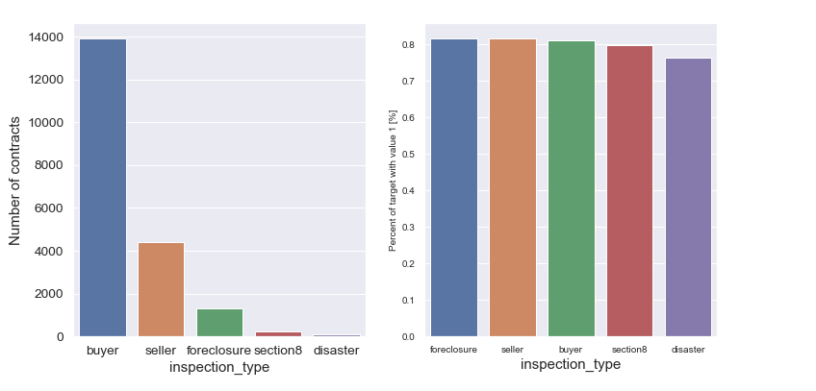
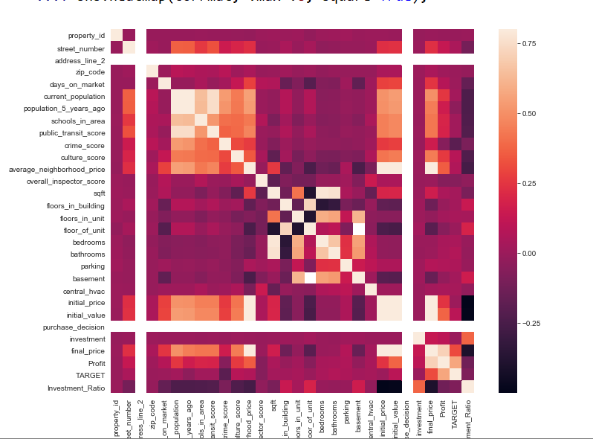
EDA

Slide 5
Methodology
Classification (logistic regression) model to identify the households that are yielding profits and the households that can be invested in, using the cleaned data set.
Linear regression model to predict the final_price for the validation set
Invested the investment amount equally amongst all potential buys.
Calculated profits by using the predicted final price (profit = final price - investment - initial price)
Took the records with highest profits and arranged them in ascending order of initial price such that the initial purchase amount does not exceed 400,000,000.

Slide 6
Evaluation
ROC curve was looked at to check if the classifier algorithm had a good predictive power
Regression models were evaluated based on AIC using stepwise regression

Slide 7
Evaluation contd..
Identified ~top 1000 properties worth $400,000,000.
Profit yield $156,000,000

Slide 8
Recommendations and Next Steps
More feature sets can be explored
Macro factors
Local Factors
Timeframe in which the profit/loss was made
Advanced models like neural networks and decision trees can be explored
Interpretability of Significant variables need to be checked
Figure out which homes will give the best ROI on upgrade investment

